Slide 1

Subrecipients/Local Public Agencies (LPAs) Title VI Program Responsibilities
U. S. Department of Transportation
Federal Highway Administration
2015 HDOT Civil Rights Symposium
Wednesday January 28, 2015
Honolulu International Airport Interisland Conference Center
by
Mohamed Sulaiman Dumbuya
FHWA Resource Center Civil Rights Title VI Specialist
mohamed.dumbuya@dot.gov

Slide 2
Session Outcomes
Recognize Delegation of Federal-aid Project Administration and Management to Subrecipients/LPAs
Define FHWA’s Title VI Program
Identify LPA Title VI Program Responsibilities

Slide 3
State Transportation Agencies &
Federal-aid Highway Funds
State Transportation Agencies (STAs) are the principal recipients of Federal-aid Highway Funds
STAs are responsible for construction of all Federal-aid projects
  “Any State desiring to avail itself of the provisions of this title shall have a State transportation department which shall have adequate powers, and be suitably equipped and organized to discharge to the satisfaction of the Secretary the duties required by this title.” (23 USC 302(a))
  “The ST[A] has responsibility for the construction of all Federal-aid projects, and is not relieved of such responsibility by authorizing performance of the work by a local public agency or other Federal agency.” (23 CFR 635.105(a))

Slide 4
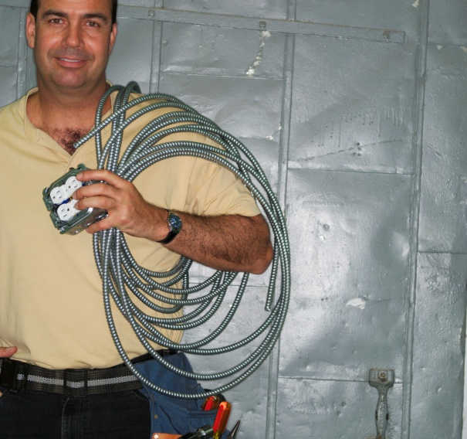

delegation of
Project management Activities
STAs may delegate Federal-aid project administration and management to subrecipients including Local Public Agencies (LPAs)
  “The State highway department may utilize, under its supervision, the services of well-qualified and suitably equipped engineering organizations of other governmental entities for making surveys, preparing plans, specifications and estimates, and for supervising the construction of any projects.” (23 CFR 1.11(b))

Slide 5

Who are Local Public agencies?
Local Public Agency
LPA SOP Template
“any city, county, township, municipality, or other political subdivision that may be empowered to cooperate with the State transportation department in highway matters” (23 CFR 635.102)
Any organization, other than the State Transportation Agency, with administrative or functional responsibilities which are directly or indirectly affiliated with a governmental body of any nation, State, or local jurisdiction

Slide 6

LPAs must abide by all Federal Requirements
LPAs are required to carry out their Federal-aid project actions in accordance with all applicable Federal requirements
  “When the work is to be performed under a contract awarded by a local public agency, all Federal requirements including those prescribed in this subpart shall be met.” (23 CFR 635.105(c)(2))

Slide 7


Nondiscrimination in the
Federal-aid Program
Nondiscrimination denotes absence of disparate treatment or impact in Federally-assisted programs and activities
Nondiscrimination in the Federal-aid program is governed by:
  Title VI of the Civil Rights Act of 1964
  The 1987 Restoration Act and
  Other Nondiscrimination authorities

Slide 8

THE 1964 CIVIL RIGHTS ACT- Titles
Title I - Voting Rights
Title II - Public Accommodation
Title III - Desegregation of Public Facilities
Title IV - Desegregation of Public Education
Title V - Commission on Civil Rights
Title VI - Nondiscrimination in Federally Assisted Programs & Activities
Title VII - Equal Employment Opportunity
Title VIII - Registration and Voting Statistics
Title IX - Intervention & Procedure after Removal in Civil Rights Cases
Title X - Establishment of Community Relations Service
Title XI - Miscellaneous

Slide 9

Title VI of the Civil Rights Act of 1964
Federal law that prohibits discrimination on the basis of race, color, or national origin in Federal programs and activities;
The law specifically states:
“No person in the United States shall on the ground of race, color, or national origin be excluded from participation in, denied the benefits of, or subjected to discrimination under any program or activity receiving Federal financial assistance.” (42 USC 2000d)

Slide 10
Civil Rights Restoration Act of 1987
Direct response to the 1984 Supreme Court decision in the Grove City College vs. Bell case (465 U.S. 555)
Restored the original intent of Title VI to include all programs and activities of Federal-aid recipients and contractors whether federally funded or not
  Federal agency nondiscrimination requirements limited to just those areas of the recipient’s operation that directly benefited from Federal assistance

Slide 11
What is FHWA’s Title VI
Program?
Not limited to prohibitions of Title VI of the Civil Rights Act of 1964
  Includes other civil rights provisions of Federal statutes & related authorities that prohibit discrimination in programs & activities receiving Federal financial assistance (23 CFR 200.5(p))
Other Nondiscrimination & Cross-cutting Authorities include:
  The 1970 Uniform Act (42 USC 4601)
  Section 504 of the 1973 Rehabilitation Act (29 USC 790)
  The 1973 Federal-aid Highway Act (23 USC 324)
  The 1975 Age Discrimination Act (42 USC 6101)
  Executive Order 12898 on Environmental Justice (EJ)
  Executive Order 13166 on Limited English Proficiency (LEP)

Slide 12

Other Federal Statutes
The 1970 Uniform Act (42 USC § 4601)
  Prohibits unfair and inequitable treatment of persons displaced or property to be acquired as a result of Federal-aid programs & projects
Section 504 of 1973 Rehabilitation Act (29 USC § 790)
  “No QUALIFIED HANDICAPPED PERSON shall, solely by reason of his handicap, be excluded from participation in, be denied the benefits of, or be subjected to discrimination under any program or activity that receives or benefits from Federal financial assistance.”
The 1973 Federal-Aid Highway Act (23 USC § 324)
  “No person shall on the grounds of SEX be excluded from participation in, be denied the benefits of, or be subjected to discrimination under any program or activity receiving Federal assistance under this title or carried on under this title.”

Slide 13

Other Federal Authorities…
The 1975 Age Discrimination Act (42 USC § 6101)
  “No person shall on the basis of AGE, be excluded from participation in, be denied the benefits of, or be subjected to discrimination under any program or activity receiving Federal financial assistance.”
Executive Order 12898 on Environmental Justice(EJ)
  “Each Federal agency shall conduct its programs, policies, and activities [including those of recipients (see FHWA Order 6640.23(2)(h))] that substantially affect human health or the environment, in a manner that ensures that such programs, policies, and activities do not have the effect of excluding persons (including populations) from participation in, denying persons (including populations) the benefits of, or subjecting persons (including populations) to discrimination under, such, programs, policies, and activities, because of their race, color, or national origin.”

Slide 14
Other Federal Authorities…
Executive Order 13166 on Limited English Proficiency (LEP)
  Federal agencies to examine their services, develop and implement processes by which LEP persons can meaningfully access those services;
  Establish guidance on how recipients can provide meaningful access to LEP persons;
  Prepare a plan with consistent standards and steps to overcome language barriers in the delivery of programs and activities;
  Ensure stakeholders have “adequate opportunity to provide input.”

Slide 15

Who Is An LEP Person?
Person who does not speak English as primary language and has limited ability to read, speak, write or understand English;
Failure to provide LEP person services or meaningful access to services [may] constitute national origin discrimination. (Lau v. Nichols, 1974)

Slide 16
Title VI Law Versus FHWA’s Title VI Program
Title VI of CRA of 1964 Coverage | FHWA Title VI Program Coverage
Race | Race
Color | Color
National Origin (LEP) | National Origin (LEP)
 | Handicap/Disability
 | Sex (Gender)
 | Age
 | Low Income & Minorities

Slide 17
In Effect FHWA Title VI Program Is…
System of requirements developed to assure nondiscrimination in programs and activities receiving Federal financial assistance on the basis of:
  Race
  Color
  National Origin (Including Limited English Proficiency (LEP))
  Sex
  Age
  Disability
  [Low]Income Status

Slide 18
LPA Title VI Program Responsibilities
Signed Assurances
  “every [award of, or] application for Federal financial assistance shall, as a condition to its approval and the extension of any Federal financial assistance pursuant to the [award or] application, contain or be accompanied by an assurance that the program will be conducted or the facility operated in compliance with all requirements imposed…” (49 CFR 21.7)
1) Signed Assurances

Slide 19
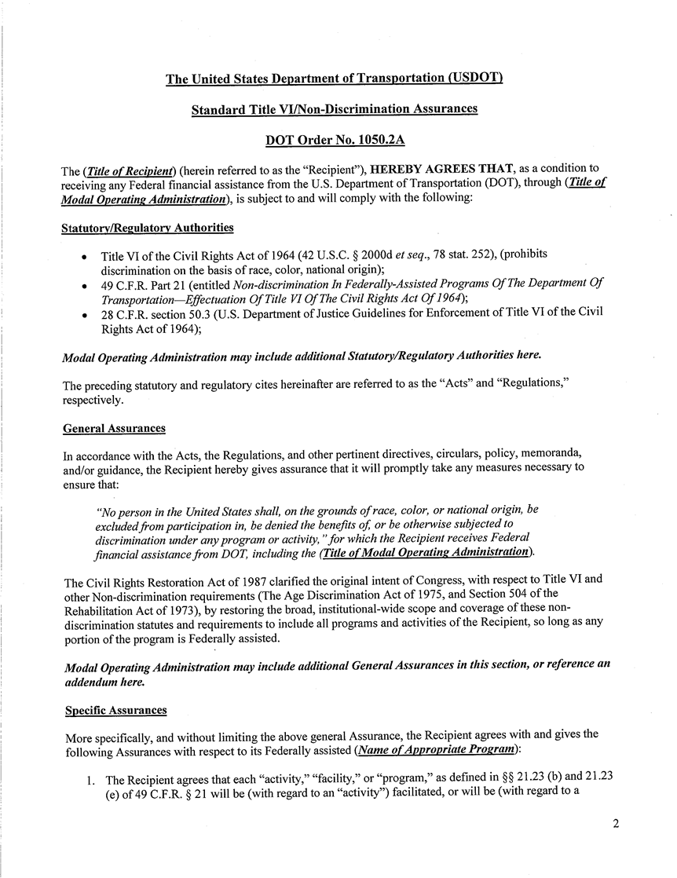


Slide 20
Signed Assurances Contd.
Failure or refusal to furnish required assurance is grounds for the termination, refusal to grant or continue Federal financial assistance
“If an applicant fails or refuses to furnish an assurance required under § 21.7 or otherwise fails or refuses to comply with a requirement imposed by or pursuant to this section, Federal financial assistance may be refused…” (49 CFR 21.13(b)&(c))

Slide 21
Methods of administration
  “The Recipient shall provide for such methods of administration …to give reasonable guarantee that it, other recipients, sub-grantees, contractors, subcontractors, transferees, successors in interest, and other participants of Federal financial assistance under such program will comply with all requirements imposed or pursuant to the Act, the Regulations and this assurance” (USDOT Assurance #9); see also 49 CFR 21.7(b).
2) Methods of Administration
Notes:
MOA – system of procedures and activities to assure compliance with nondiscrimination requirements.

Slide 22

Methods of administration Contd.
Minimum Requirements
  Public outreach & education plan/procedures
  Training program for staff and others
  Procedures for processing complaints
  Program to assess (review) and periodically report on status of Title VI compliance
  Detailed plans for bringing discriminatory programs into compliance
  Data collection procedures and methods
MOAs are contained in a Title VI Nondiscrimination Implementation Plan

Slide 23
Implementation Plan
3) Title VI Nondiscrimination Implementation Plan
  Title VI Nondiscrimination Statement of Policy
    Express commitment to Title VI Nondiscrimination obligation
    Policy signed by Chief Administrative Officer
    Policy statement circulated throughout organization & public
  Organization & Structure
    Depict the MARS of the Nondiscrimination Program
    Designate Title VI Coordinator, Manager or Specialist
    Outline role(s), responsibilities and authority

Slide 24

Implementation Plan Contd.
Procedures for Assuring Compliance and Enforcement
  Outreach, training, reviews, data collection, complaint process and enforcement
Accomplishment Report
    Accomplishments made since last report/update
      Title VI Nondiscrimination issues identified and addressed
      Reviews conducted
      Summary and status of complaints filed

Slide 25
Implementation Plan Contd.
  Annual Work Plan
    Outline Title VI Program monitoring and review activities planned for the coming plan year
    State by whom each activity will be accomplished and target date for completion
  Required Title VI Nondiscrimination Contract Provisions
    Procedures to ensure Title VI Nondiscrimination provisions are included in all Federally-funded contracts regardless of tier (Appendix A of USDOT Order 1050.2A)
      Nondiscrimination in selection and retention of subcontractors; procurement of materials and leases of equipments
      Nondiscrimination in notification of Title VI obligation to each potential subcontractor or supplier

Slide 26

Implementation Plan Contd.
  Disadvantaged Business Enterprises (DBE)
  Participation by Small Business Enterprises
    Procedures to ensure that DBEs are afforded opportunity to participate in Federal-aid Highway programs and activities
    “It is declared to be in the national interest to encourage and develop the actual and potential capacity of small business and to utilize this important segment of our economy to the fullest practicable extent in construction of the Federal-aid highway systems, including the Interstate System. In order to carry out that intent and encourage full and free competition, the Secretary should assist, insofar as feasible, small business enterprises in obtaining contracts in connection with the prosecution of the highway program.” (23 USC § 304) &
    (49 CFR 26, effective 2/2011)

Slide 27
Title VI Program agreements
Abbreviated Title VI Program Plans for LPAs serving a population less than 100,000
Key Elements include:
  Assurances
  Implementing Procedures
  Complaint Procedures
  Sanctions
  Signatures

Slide 28

Is the LPA, Contractor or Consultant required to have a Title VI Program Implementation Plan?
First, you need to determine if the party is a Recipient or a Contractor/Consultant/Vendor
If a Recipient, they are required to have an Implementation Plan (Method of Administration)
If a Contractor, etc. they are not required to have an IP

Slide 29
Who is a [Sub]recipient?
Recipient
  An entity or person to whom Federal assistance is directly extended and thereby subjects them to Title VI compliance obligations (23 CFR 200.5(n))
Subrecipient
  An entity or person to whom Federal assistance is indirectly extended either through a recipient or another subrecipient and thereby subjects them to Title VI compliance obligations (23 CFR 200.5(n))

Slide 30
Who is a Contractor?
A Contractor/Subcontractor
  “..any person, corporation, partnership, or unincorporated association that holds a FHWA direct or federally assisted construction contract or subcontract regardless of tier”
  (23 CFR 230.407 (i))
  “One who participates, through a contract or subcontract (at any tier), in a DOT-assisted highway, transit, or airport”
  (49 CFR 26.5)

Slide 31
What is the Distinction between a Recipient & a Contractor?
Recipient/Subrecipient | Contractor/Subcontractor, Consultant, Vendor
Provides services | Sells deliverables (goods & services)
Signs an Assurance Not necessarily in business to make profit (Usually, public entity) | Signs a Contract with contract provisions In business (buy & sell) to make profit (Operates in a competitive environment)
Receives FFA (or paid) whether service is expensed as a deliverable or not | Is paid for a specific deliverable *Receipt of payment with FFA does not establish a recipient/subrecipient relationship
Designs a program to meet a broader goal | Provides specific product or service ancillary to a Federal program
Is receiving Federal financial assistance | Could become a recipient with provision of [Federal financial] assistance.

Slide 32

Key Points
LPAs must carry out Federal-aid Highway projects in accordance with all applicable Federal requirements
LPAs must have Signed Assurances (USDOT 1050.2A)
  They are binding agreements
  Failure or refusal to furnish required signed assurances may result in refusal of Federal financial assistance
Methods of Administration & Implementation Plans
Nondiscrimination Agreements (Population < 100,000)
Ceteris paribus, Only Recipients, Not Contractors, are required to have Title VI Program Implementation Plan

Slide 33

Title VI In Summary
Title VI Program is not a bureaucratic exercise
  About preserving the vitality & viability of American economy
  Represents statutory, contractual & constitutional requirements
  Evokes our social/civic obligations
  Echoes our Professional ethics
  Reminds us of our moral imperatives and values
IT IS ABOUT DOING THE RIGHT THING!
Ua Mau ke Ea o ka ‘Aina I ka Pono

Slide 34
Resources
Federal-Aid Program Administration LPA Website
http://www.fhwa.dot.gov/federalaid/lpa/index.cfm
Sample Title VI/Nondiscrimination Plan and Nondiscrimination Agreement (WSDoT) http://www.wsdot.wa.gov/publications/manuals/fulltext/M36-63/Lag28.pdf
DOJ Title VI Manual
http://www.justice.gov/crt/about/cor/coord/vimanual.php

Slide 35
Concerns??
Questions ??
Comments??
Suggestions ??

Slide 36



THE END
Fa'afetai
Mālō / Mālō ‘aupito
Xièxiè
Agyamanak

